Slide 1
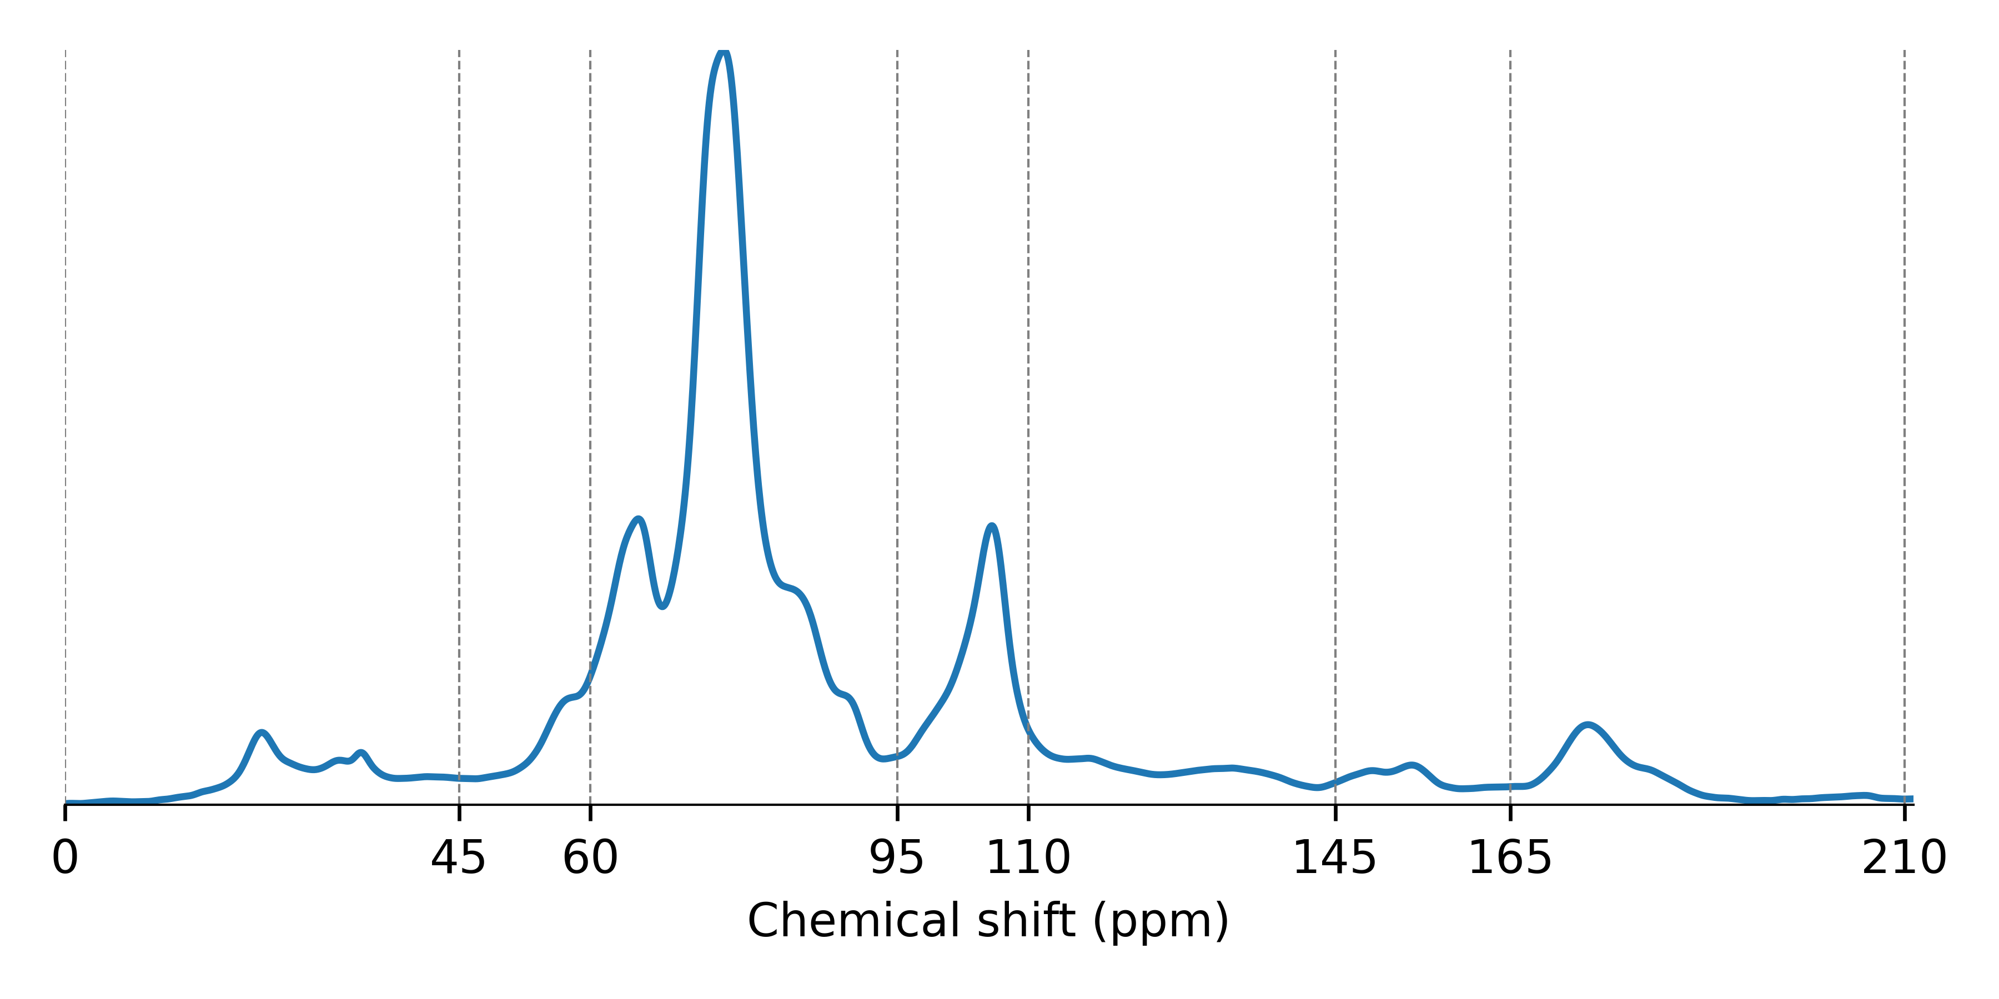






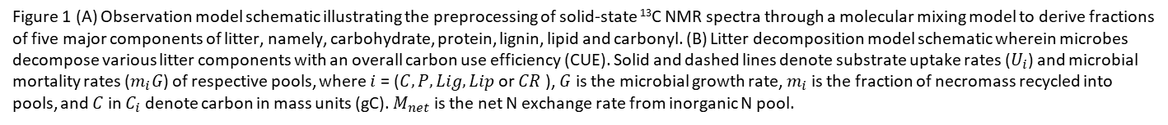





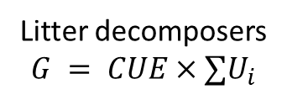

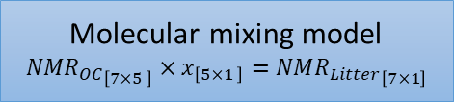





Figure 1
(A)
(B)
Alkyl C
Methoxy
O-alkyl
Aromatic
Phenolic
Carbonyl
Carbohydrate ($C_{h}$)
$$m_{C_{h}}G$$
$$R=\left(1−CUE\right)∑U_{i}$$
di-O-alkyl
$$U_{C_{h}}$$
CO₂
Protein ($P$)
$$m_{P}G$$
$$U_{P}$$
C
Lignin ($L_{g}$)
$$m_{L_{g}}G$$
Litter decomposers
$$G = CUE×∑U_{i}$$
$$U_{L_{g}}$$
Molecular mixing model
$${{NMR}_{OC}}_{\left[7×5 \right]}×x_{\left[5×1 \right]}=NM{R_{Litter}}_{\left[7×1\right]}$$
N
Lipid ($L_{p}$)
$$U_{L_{p}}$$
$$m_{L_{p}}G$$
$$M_{net}$$
Carbonyl ($C_{n}$)
$$U_{C_{n}}$$
Inorganic N
Carbohydrates
Proteins
Lignins
Lipids
Carbonyls
$$m_{C_{n}}G$$
Figure 1 (A) Observation model schematic illustrating the preprocessing of solid-state ¹³C NMR spectra through a molecular mixing model to derive fractions of five major components of litter, namely, carbohydrate, protein, lignin, lipid and carbonyl. (B) Litter decomposition model schematic wherein microbes decompose various litter components with an overall carbon use efficiency (CUE). Solid and dashed lines denote substrate uptake rates ($U_{i}$) and microbial mortality rates ($m_{i}G$) of respective pools, where $i$ = ($C, P, Lig,Lip$ or $CR$ ), $G$ is the microbial growth rate, $m_{i}$ is the fraction of necromass recycled into pools, and $C$ in $C_{i}$ denote carbon in mass units (gC). $M_{net}$ is the net N exchange rate from inorganic N pool.
$${NMR}_{OC}×x={NMR}_{Litter}$$

Slide 2
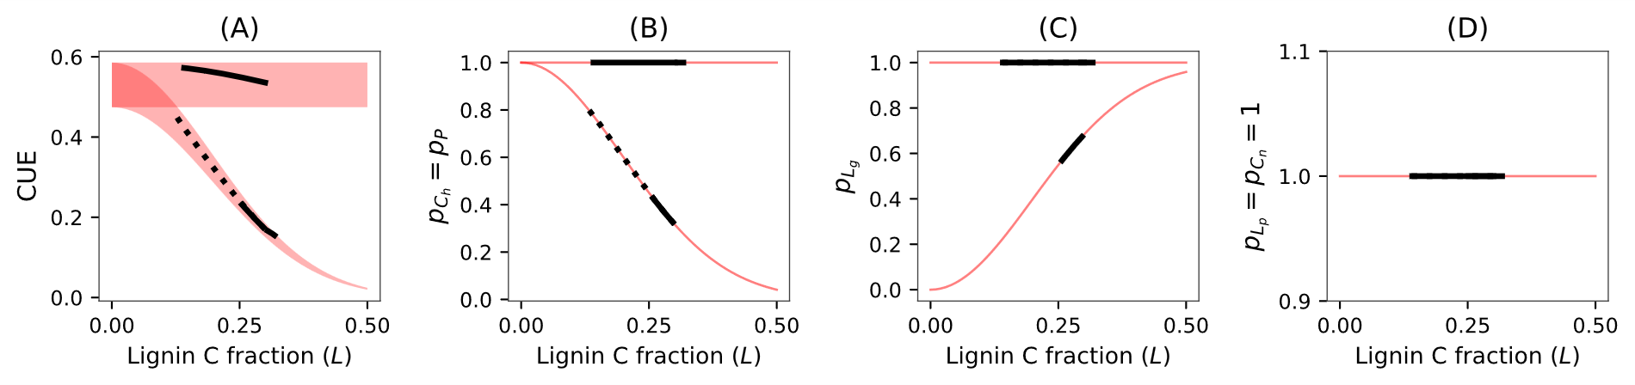

Lignin
Uptake of $C_{h}$ and $P$
CUE
Figure 2
Trade off in litter decomposer traits
more lignin → more shielding → less uptake of carbohydrate and proteins
more lignin → more investment in ligninolytic enzymes → less CUE
NPNE, NPWE
NPNE, NPWE, PWOE
NPNE
PWOV
NPNE, NPWE, PWOE, PWOV
PWOE, PWOV
NPWE, PWOE, PWOV

Slide 3
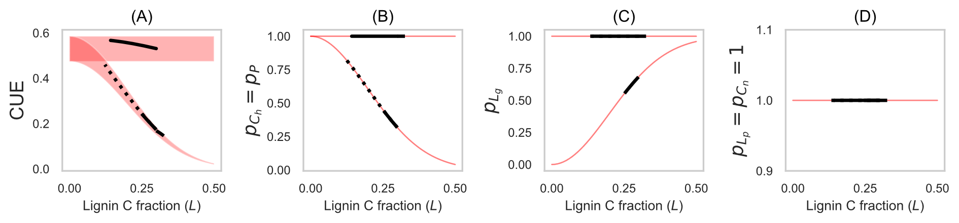

Lignin
Uptake of $C_{h}$ and $P$
CUE
Figure 2
Trade off in litter decomposer traits
more lignin → stronger shielding → lower uptake of carbohydrate and proteins
more lignin → higher investment in oxidative enzymes → lower CUE
NPNE, NPWE, PWOE
NPNE, NPWE
NPNE
PWOV
All scenarios
NPWE, PWOE, PWOV
PWOE, PWOV

Slide 4
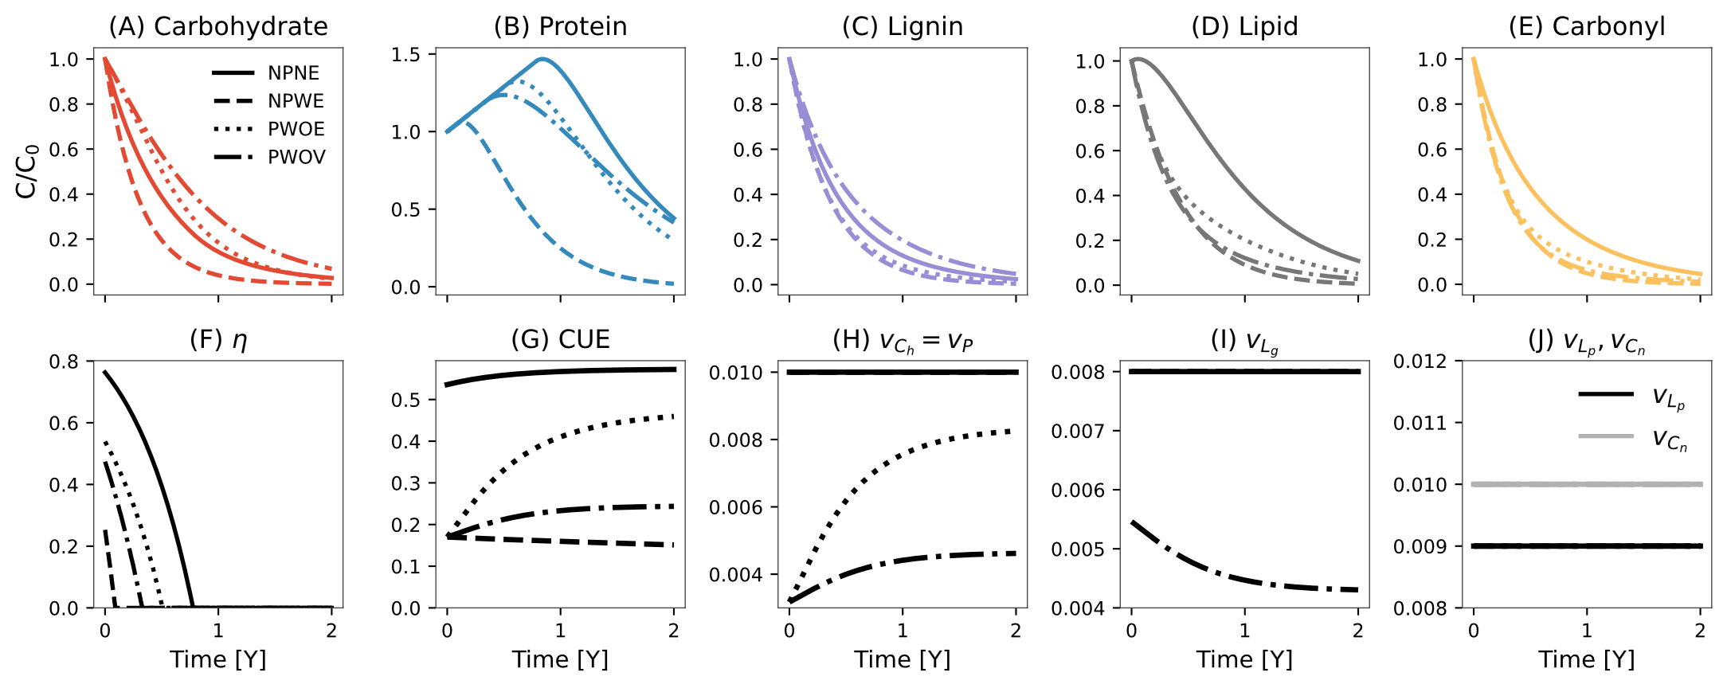
Figure 3
NPNE
NPNE, NPWE
NPNE, NPWE, PWOE
PWOE
PWOE
PWOV
NPNE, NPWE, PWOE,
PWOV
NPWE
PWOV
PWOV

Slide 5
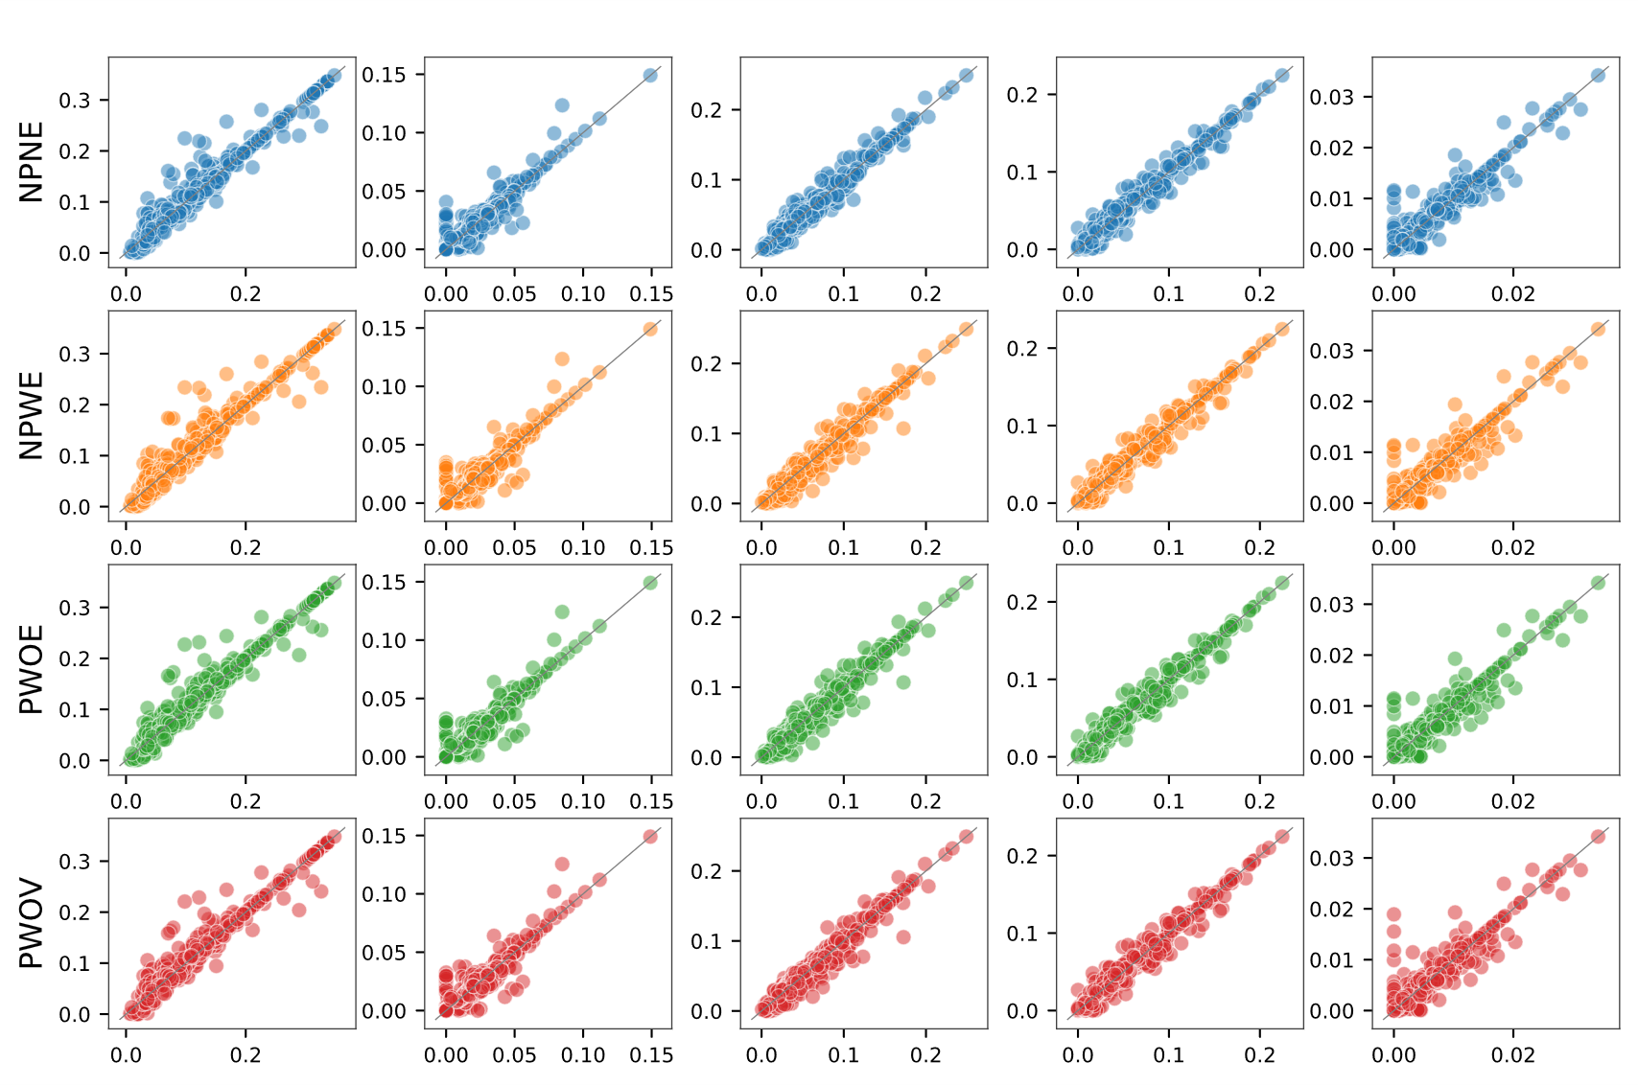
Observed vs Simulated [gC] for Each Model and Compound (flexible CUE)

Slide 6
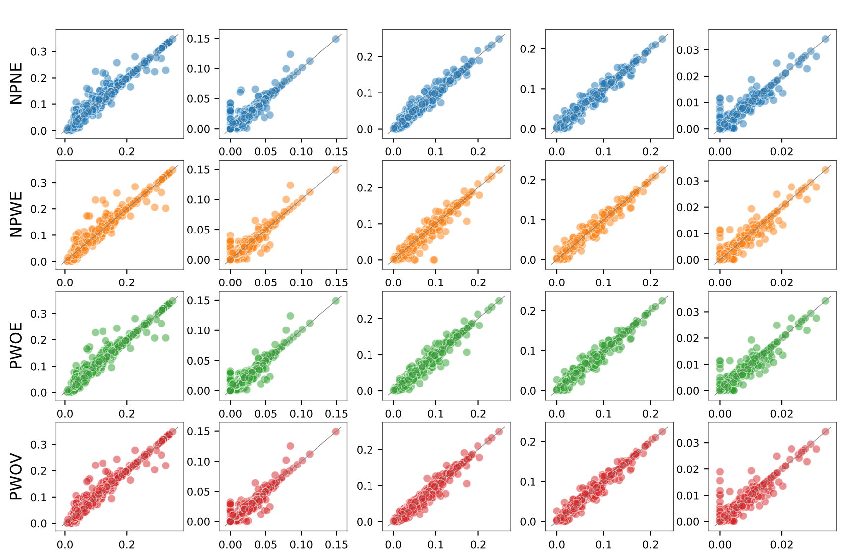
Observed vs Simulated [gC] for Each Model and Compound (N Retention)

Slide 7
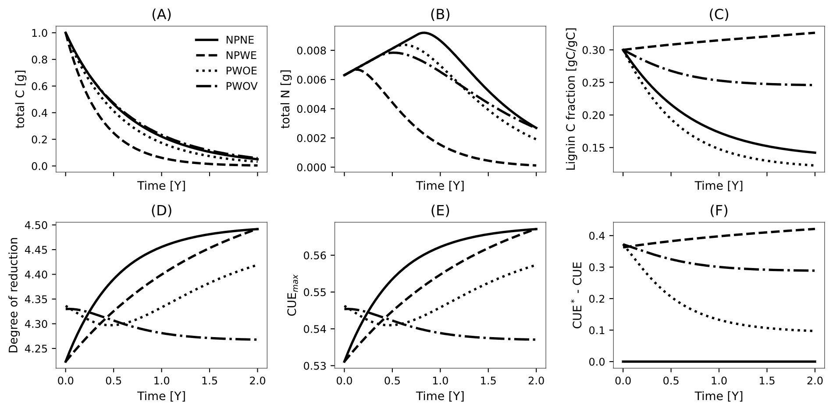

Slide 10
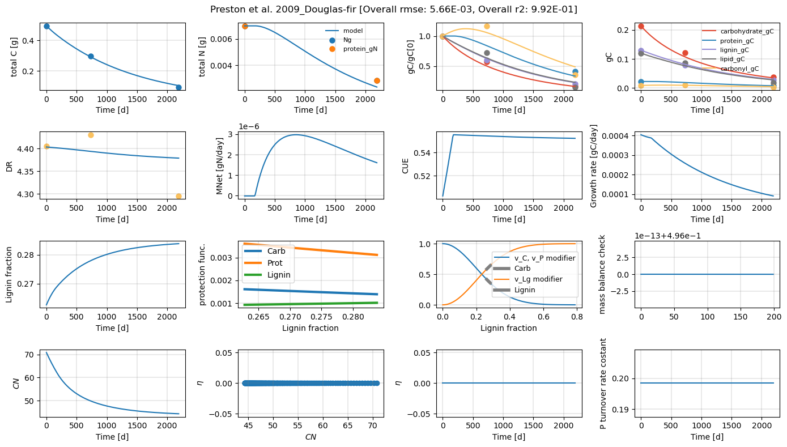

Slide 11
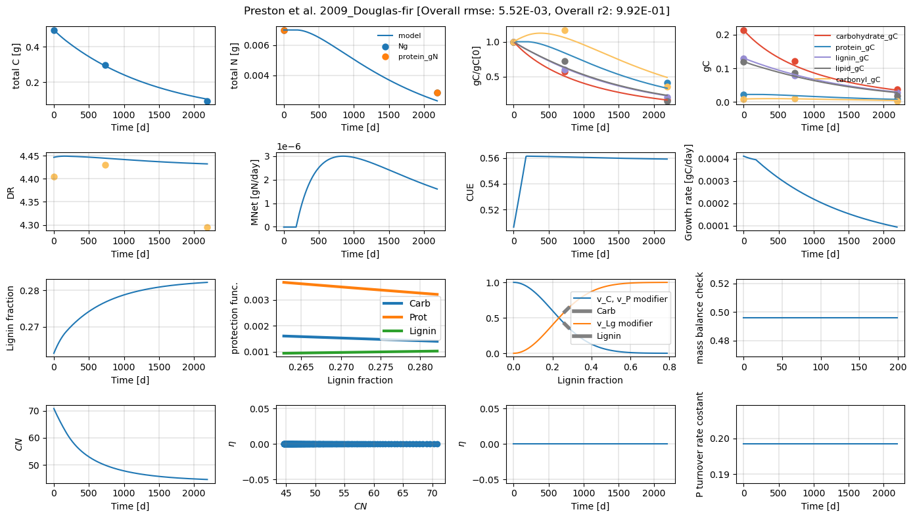

Slide 12
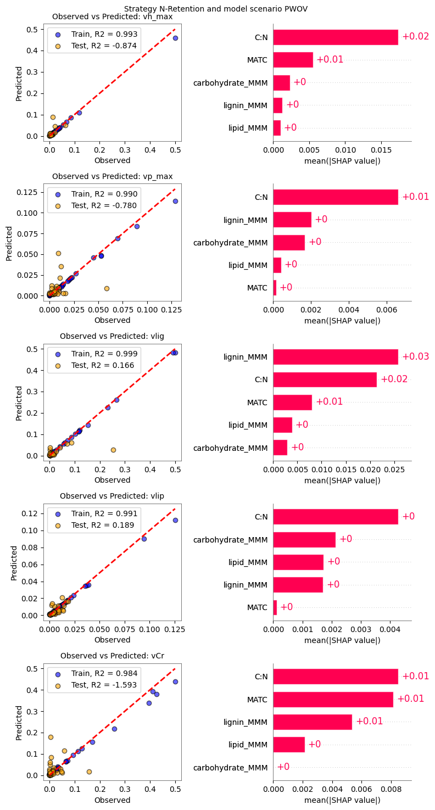
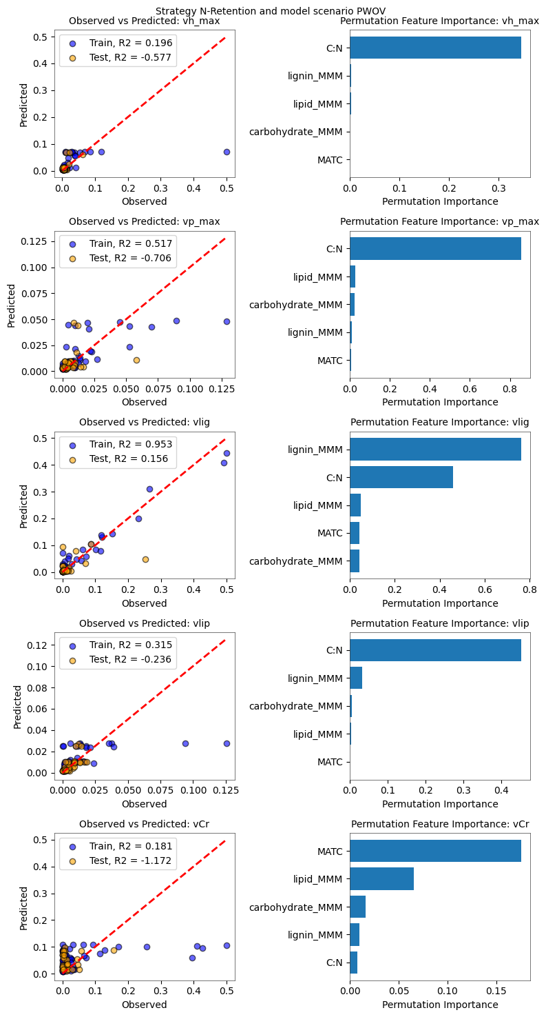
Random forest
Each row is a different rate constant; left panel scatter plot with training and testing data, and right with feature importance
XGBOOST
Overall poor model fit and MAT not a significant predictor!!

Slide 13
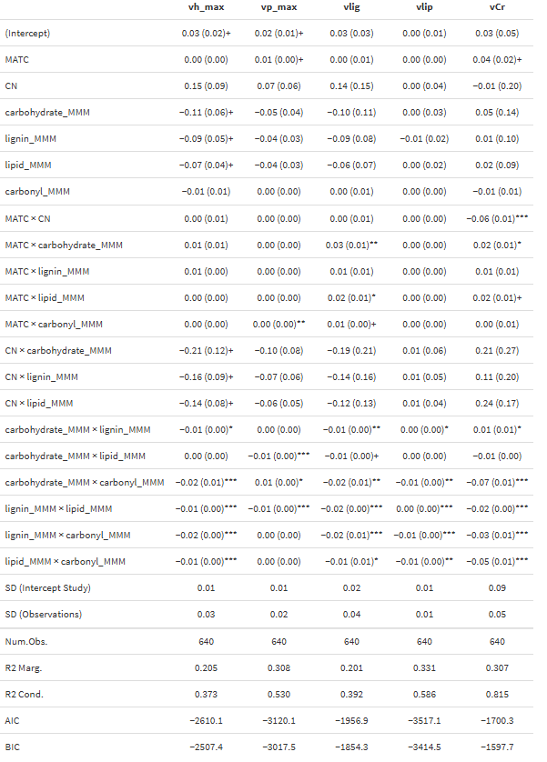
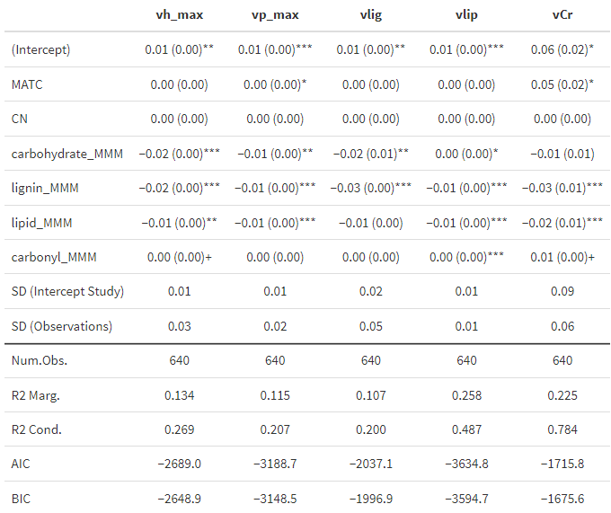
Full model without interactions
Full model with interactions
Click on html file for higher res table
Overall poor model fit and MAT not a significant predictor!!

